Slide 1
AGRIVISTA
Smart. Precision. Agriculture
Created By: Dhruvin Patel (22BECE30255)
Rohang Shah (22BECE30424)
Yash Shah (22BECE30426)
Raj Prajapati (22BECE30383)
Group: G-5
Class: 6-F

Slide 2
Abstract
AgriVista - A Smart Agriculture Platform
AgriVista is a digital solution for precision agriculture aimed at empowering farmers and stakeholders.
Sources soil quality data from government websites (e.g., soilhealth.dac.gov.in).
Integrates user inputs like rainfall and location with real-time weather forecasts.
Simulates crop growth cycles, predicting yield over time with accuracy.
Features a 3D visualization of crop development to showcase growth, ripening, or decay.
Enhances sustainable farming practices through data-driven insights.

Slide 3
System Definition
What is AgriVista?
A smart platform designed to optimize agricultural planning and management.
Purpose of the System:
Provide farmers with reliable, data-driven crop insights.
Predict yields and visualize growth based on real-time environmental factors.
Key Components:
Data sourcing from government and user inputs.
Predictive analytics for crop cycles.
3D simulations for user-friendly visualization.

Slide 4
Advantages of AgriVista
Enhanced Decision-Making: Farmers receive reliable recommendations for resource allocation.
Accurate Predictions: Combines soil, rainfall, and weather data for precise yield forecasting.
User-Friendly Design: Simple interface with multilingual and offline support.
Sustainability: Encourages efficient resource use, reducing waste and environmental impact.
Scalability: Adapts to large datasets and diverse user bases.
Visualization Tools: 3D simulations improve understanding of crop conditions.

Slide 5
System Analysis
Stakeholders:
Farmers, agronomists, policymakers, and agricultural advisors.
Key Requirements:
Accurate integration of soil and weather data.
Reliable data analytics for yield predictions.
Challenges Identified:
Limited internet access in rural areas.
Variability in data accuracy from external APIs.

Slide 6

User Module
Target Audience:
Farmers, agronomists, agricultural students, and advisors.
Features:
Input rainfall, soil quality, and location data for analysis.
Receive crop-specific recommendations and predictions.
Analyze 3D simulations of crop growth or decay.
User-Friendly Design:
Multilingual interface for accessibility.
Offline functionality for low-connectivity regions.
Output:
Actionable insights for crop planning and management.

Slide 7
Administrator Module
Admin Responsibilities:
Manage user accounts, permissions, and data inputs.
Update and maintain datasets, such as soil and weather data.
Monitor system performance and troubleshoot issues.
Key Features:
Data dashboard for tracking usage and system analytics.
Tools for ensuring data security and integrity.
Ability to validate user input for accuracy.
Outcome:
Smooth operation of the system and consistent user support.

Slide 8
Design Constraints
Technical Constraints:
Limited compatibility with older devices and outdated hardware.
Dependence on third-party APIs for soil and weather data.
Operational Constraints:
Difficulty in real-time updates in areas with poor internet connectivity.
Challenges in scaling the system for a growing user base.
User Constraints:
Farmers with limited technical knowledge may need additional training.
Adaptation required for specific regional agricultural needs.

Slide 9
UML Diagrams for AgriVista
A Data Flow Diagram (DFD): DFD for AgriVista will visually represent how soil data, user inputs, and weather forecasts are collected, processed, and transformed into crop yield predictions and 3D simulations, ensuring clear system understanding and efficient design.
Sequence Diagram: Shows the process flow for user data input, analysis, and yield prediction.
Activity Diagram: Details each process step from data sourcing to providing 3D visual outputs.

Slide 10
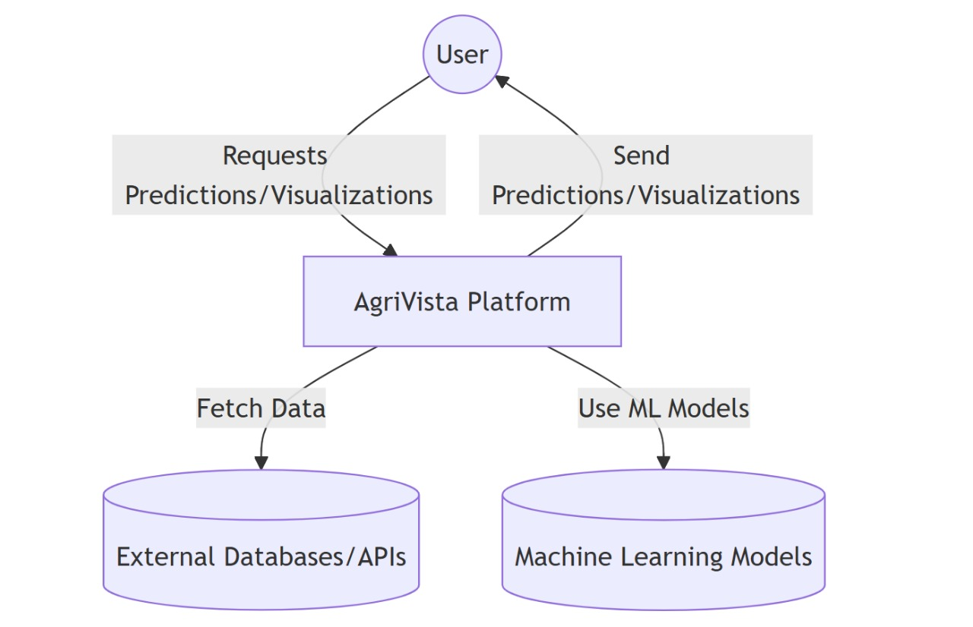
DFD Level 0:

Slide 11
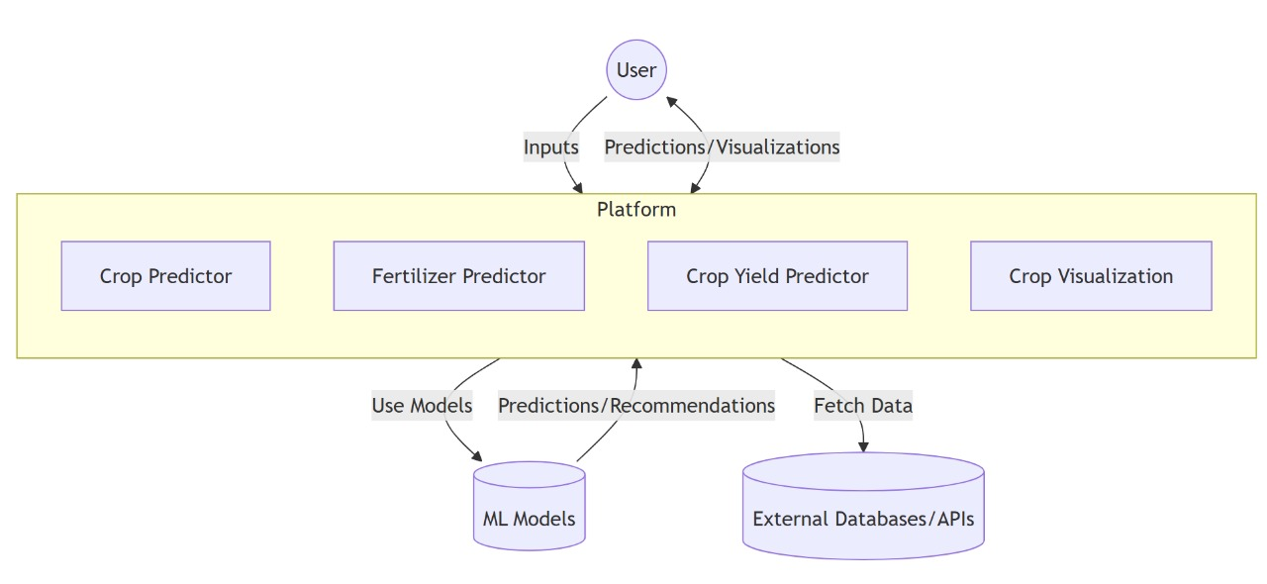
DFD Level 1:

Slide 12
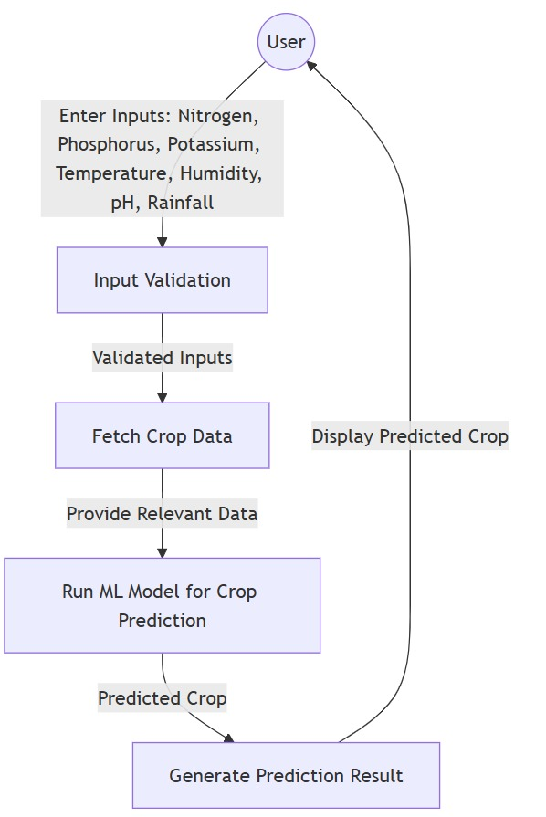
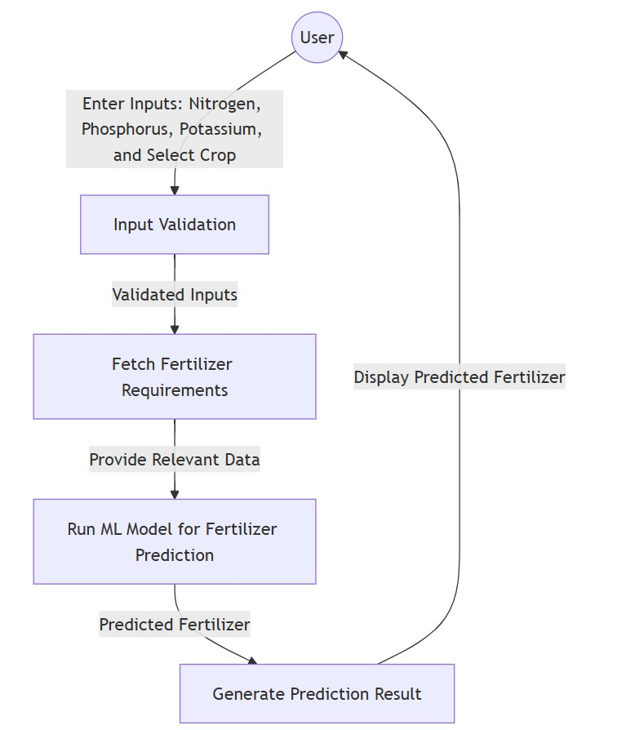
DFD Level 2 Crop Prediction: DFD Level 2 Fertilizer Prediction:

Slide 13
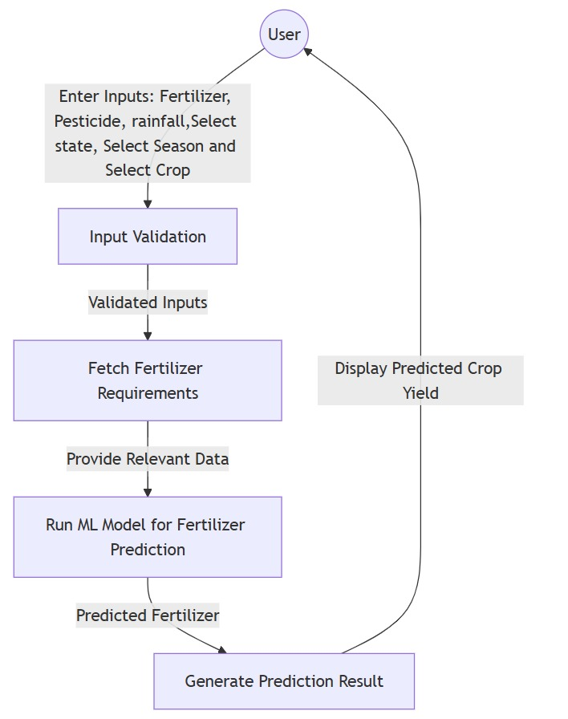
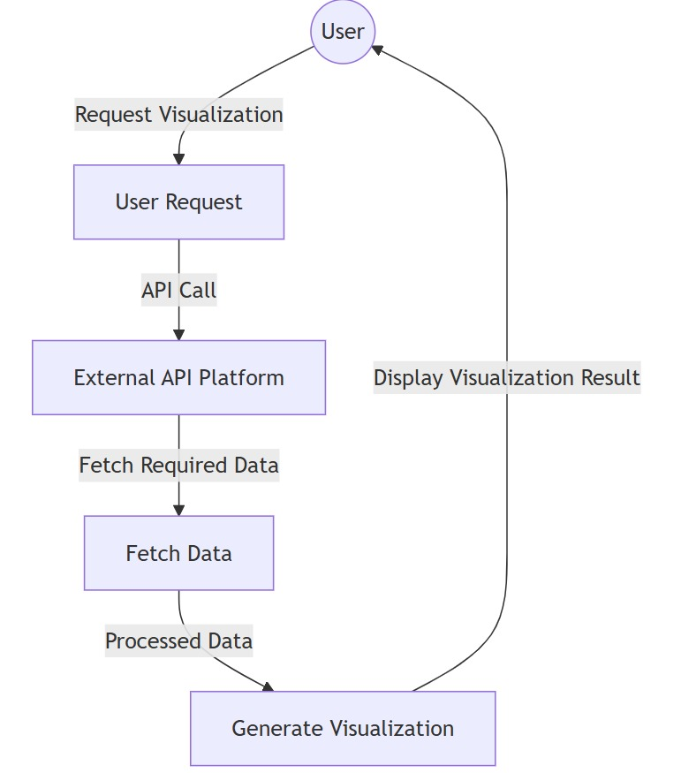
DFD Level 2 Crop Yield Prediction: DFD Level 2 Crop Visualization:

Slide 14
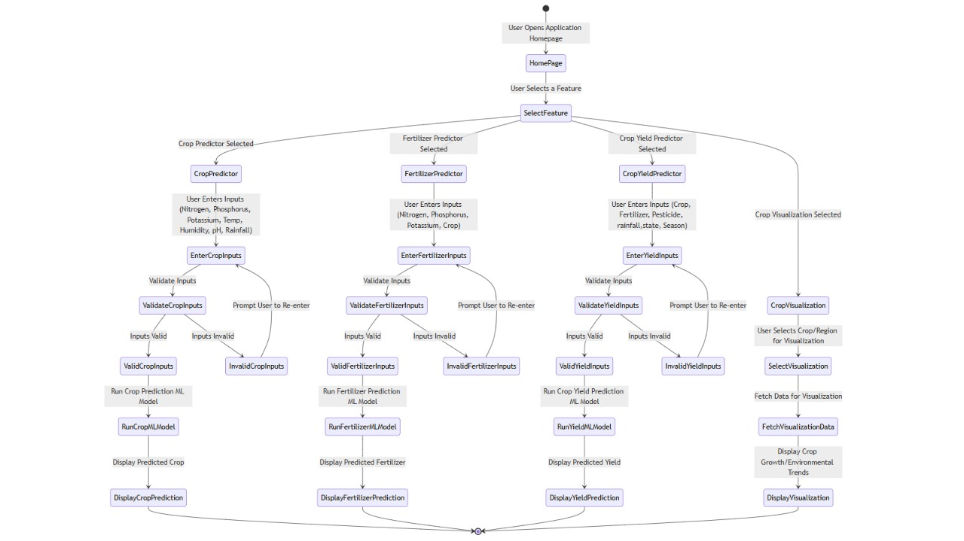
Activity Diagram

Slide 15
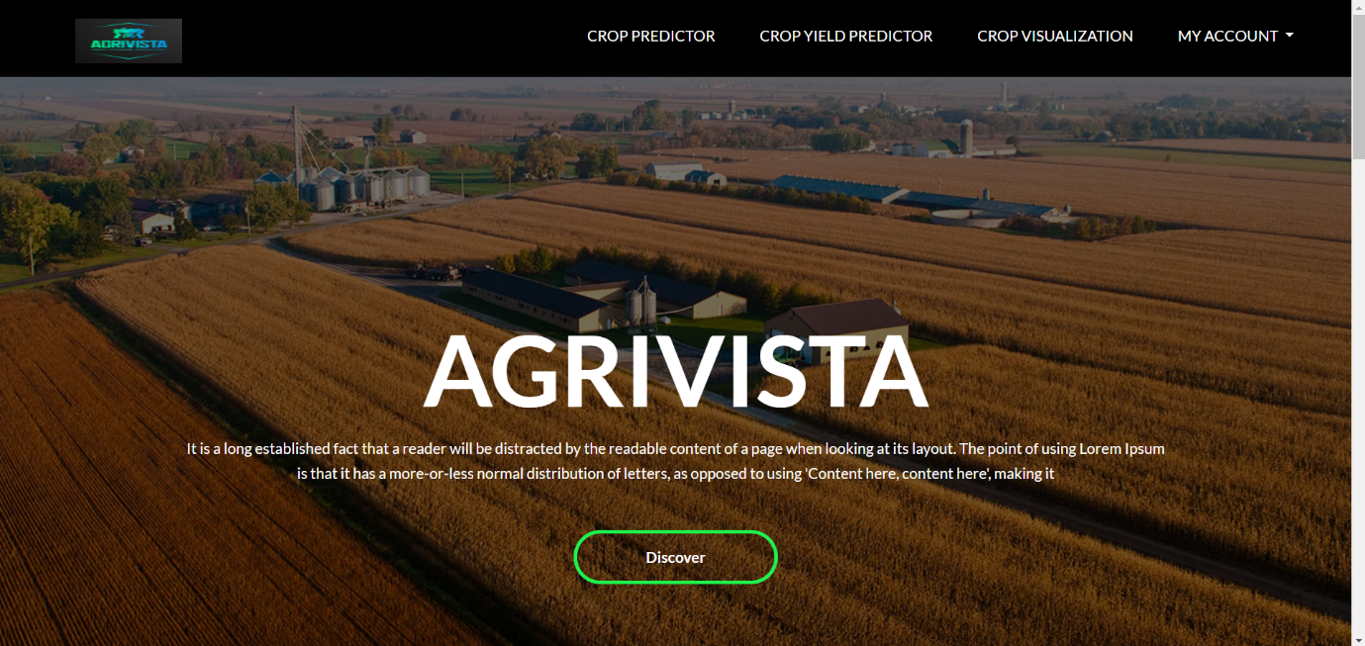
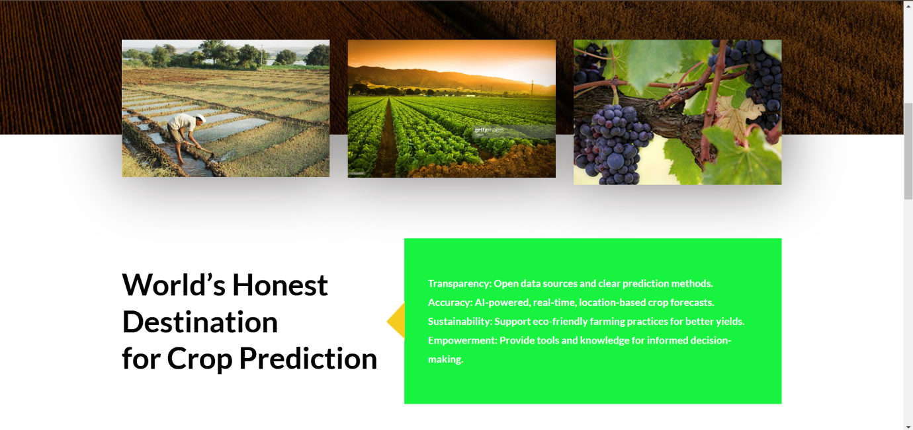
Screenshots:

Slide 16
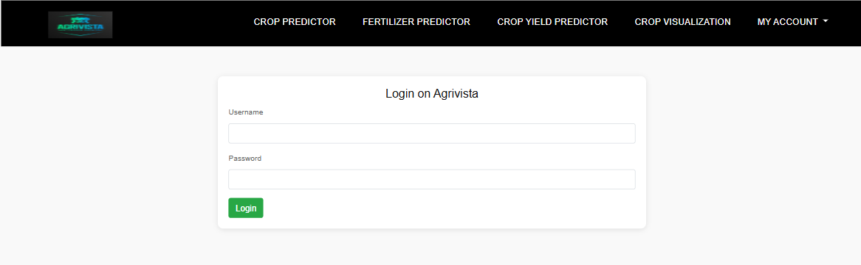
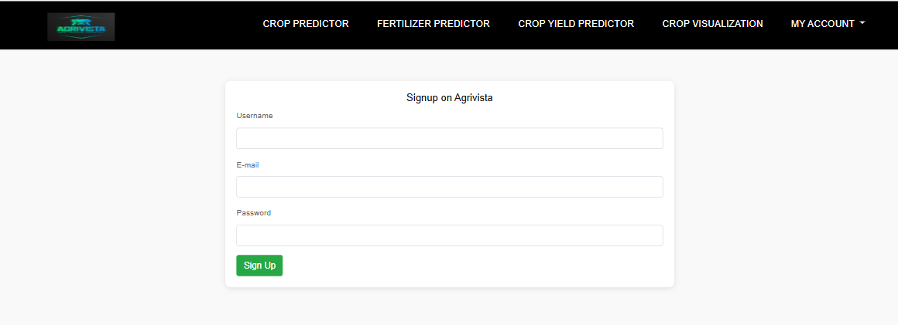
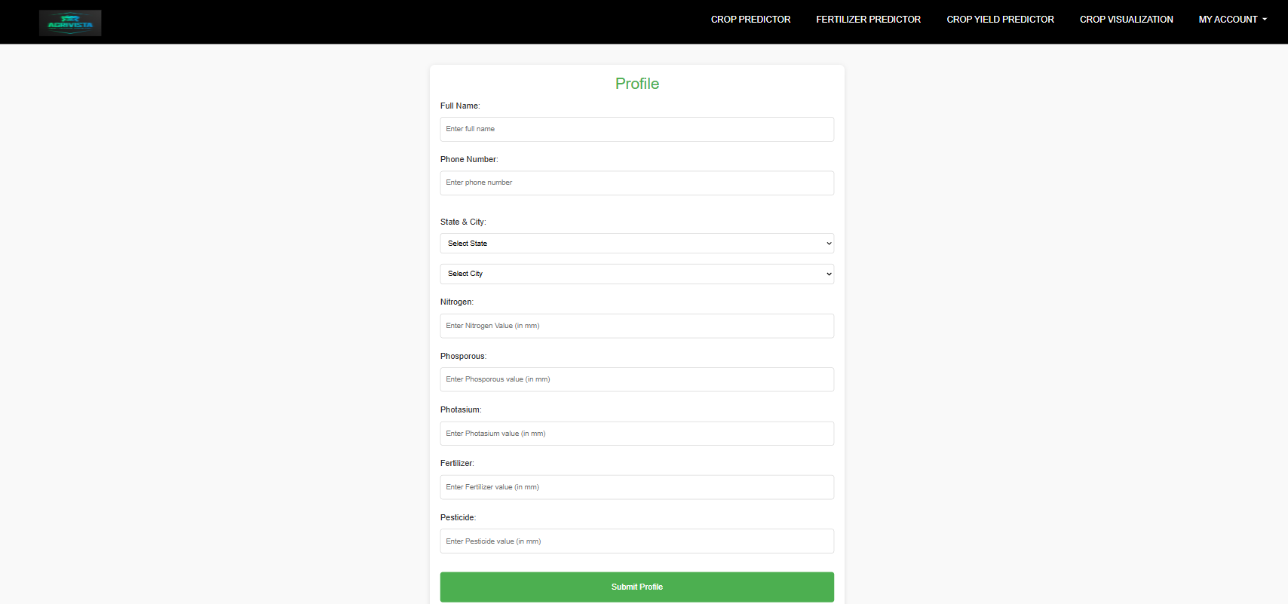

Slide 17
THANK YOU

